Slide 1
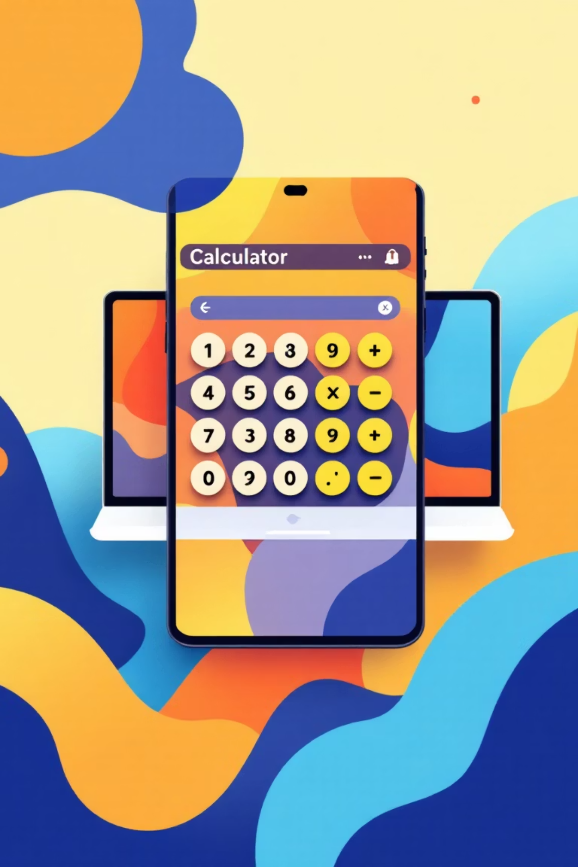
Advanced GUI Calculator
Built with Python & Tkinter | NextHikes IT Solutions Project 2

Slide 2
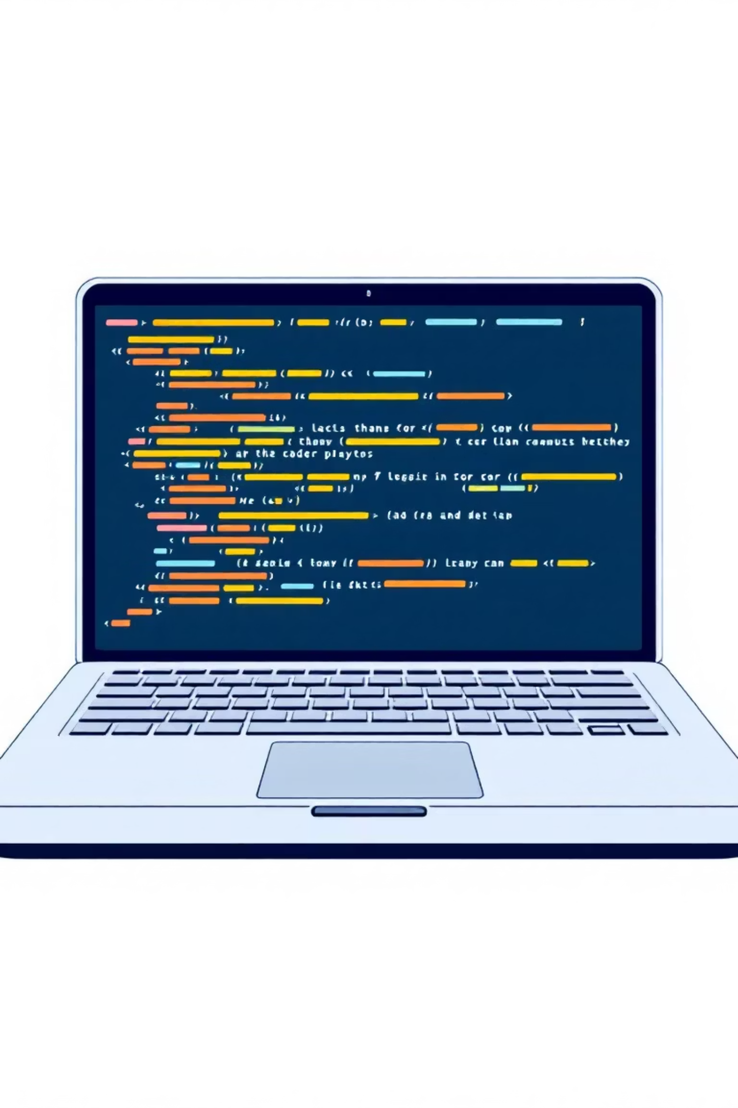
Project Overview
Purpose & Vision
Core Technology
This project demonstrates advanced GUI programming by building a fully functional, modern calculator application. Beyond basic arithmetic, it showcases event handling, user experience design, and practical Python development skills.
Built entirely with Python and Tkinter, the application combines traditional desktop GUI patterns with modern interface design. It serves as a comprehensive example of desktop application development.

Slide 3

Essential Requirements
Display Area
Button Grid
Clear equation display showing current input and calculation history
Numerical buttons (0-9) and operators (+, −, ×, ÷) in intuitive layout
Core Functions
GUI Framework
Clear (C) button and equals (=) for evaluating mathematical expressions
Complete interface built using Python with Tkinter library

Slide 4

Advanced Features Implemented
Dark/Light Mode Toggle
Dynamic theme switching allows users to choose their preferred visual style, reducing eye strain and improving accessibility
Keyboard Input Support
Full keyboard integration enables faster input—type numbers and operators directly without clicking buttons
Calculation History Panel
Persistent history tracking displays previous calculations, allowing users to reference past results
Smart Error Handling
Comprehensive error detection prevents crashes from invalid input and provides user-friendly error messages

Slide 5
Technology Stack
Python
Tkinter & ttk
Core programming language providing the logic and computational foundation for all calculator operations
Standard GUI library for creating windows, buttons, and interactive elements with themed styling capabilities
VS Code
GitHub
Integrated development environment used for writing, debugging, and testing the application code
Version control platform for managing code changes, collaboration, and project documentation

Slide 6
Development Challenges
01
02
UI Alignment Issues
eval() Security Risks
Buttons and display elements weren't positioning correctly, creating an unprofessional appearance
The eval() function caused application crashes with invalid input and posed potential security vulnerabilities
03
04
Theme Color Persistence
Keyboard Capture Problems
When switching themes, some UI elements weren't updating their colors properly across all components
Keyboard inputs weren't being detected correctly, preventing efficient calculator operation

Slide 7

Solutions & Implementation
Structural Improvements
Feature Enhancements
Grid System: Implemented frames with grid geometry manager for precise, responsive button layout
Theme Function: Created centralized theme update function that refreshes all UI element colors
Error Protection: Wrapped eval() in try/except blocks to catch and handle invalid expressions gracefully
Key Binding: Used root.bind() to capture keyboard events and route them to calculator functions

Slide 8





Application Workflow
Input Entry
User clicks button or types keyboard input
Display Update
Expression updates in real-time on screen
Evaluation
"=" key triggers calculation logic
Result Display
Answer shown immediately in display
History Saved
Calculation stored in history panel
Users can toggle between dark and light themes at any point during operation, with all preferences preserved throughout the session.

Slide 9
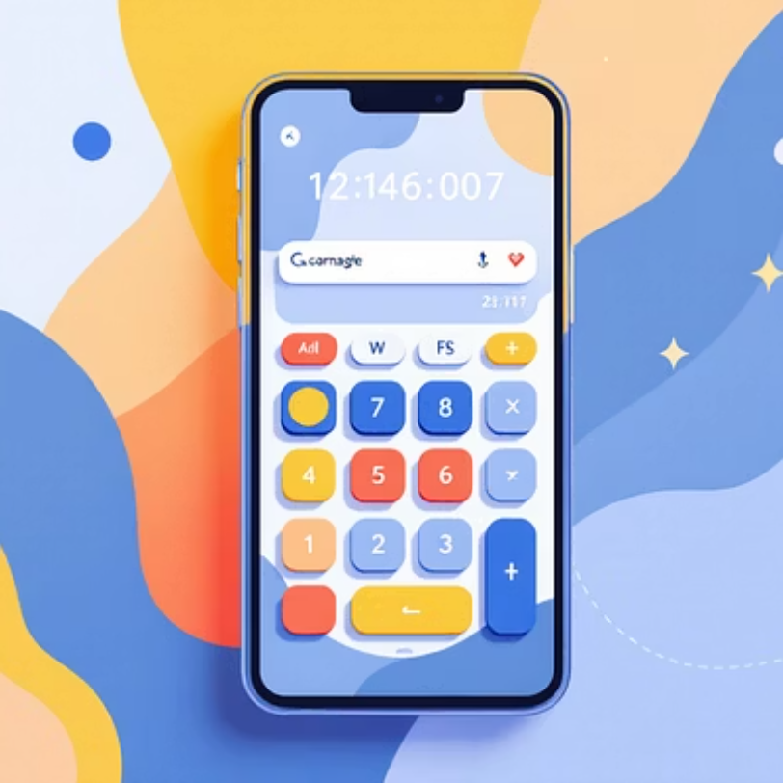
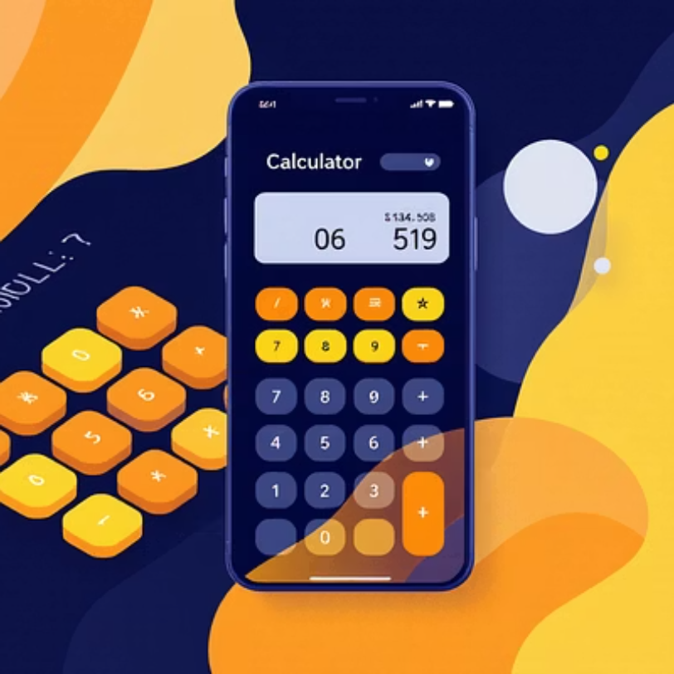
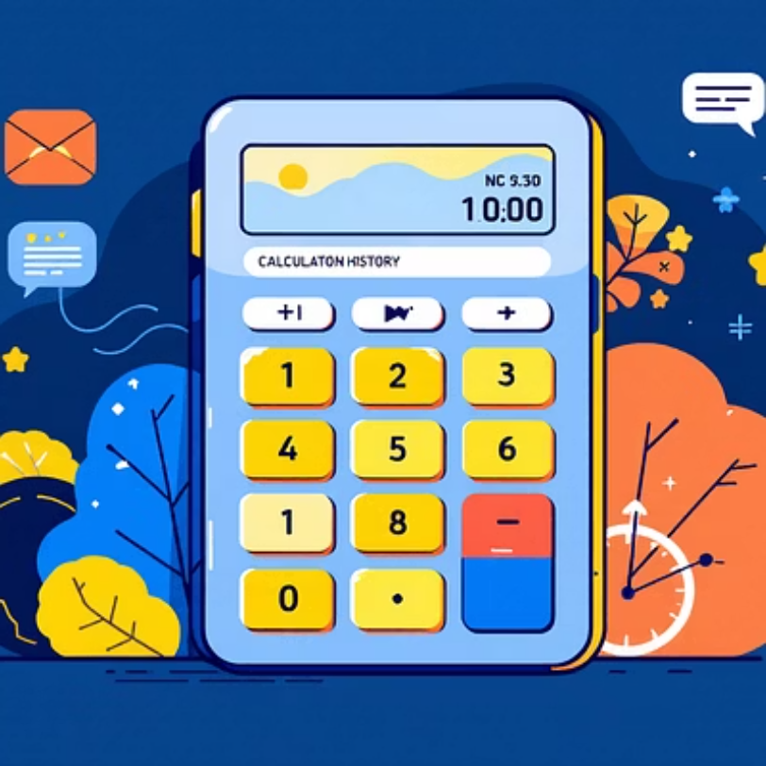
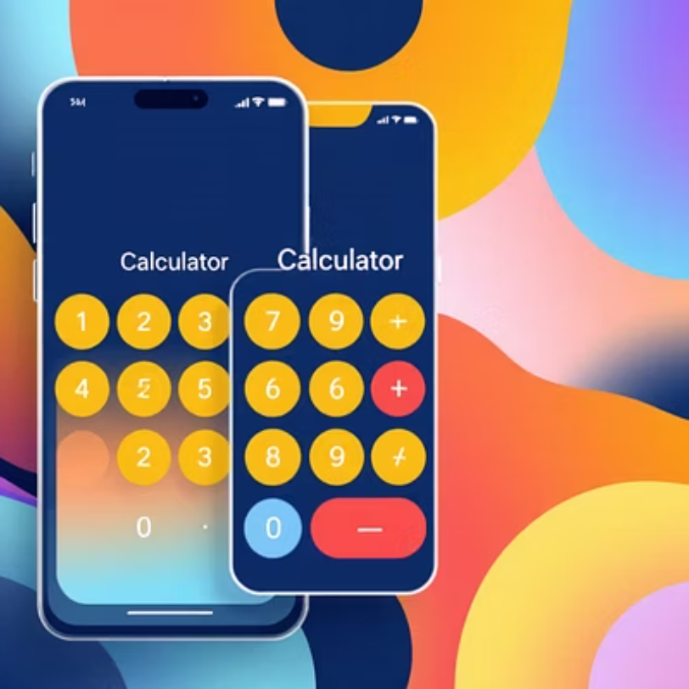
Application Screenshots
The screenshots showcase both theme modes, the calculation history feature, and the clean, intuitive button layout that makes the calculator easy to use.

Slide 10

Key Takeaways
Project Success
Enhanced UX
Successfully built a fully functional, modern GUI calculator that exceeds basic project requirements
Integrated advanced features including theme switching, keyboard support, and history tracking for superior user experience
Skills Developed
Gained practical expertise in GUI development, event handling, error management, and Python application architecture

